Slide 1
Ram Prasad
Sales Dashboard Project in Tableau
I developed an interactive Sales Dashboard using Tableau to provide actionable insights into sales performance. The project aimed to empower decision-making for sales teams and executives by visualizing key metrics and trends.
Project Overview
Objective:
→ Develop a Sales Dashboard to provide actionable insights into sales performance.
Purpose:
→ Enable data-driven decision-making for sales teams and executives.
Key Features:
→ Interactive visualizations, complex calculations, and user-friendly design.

Slide 2
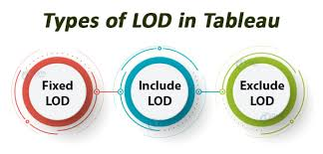
Data Handling
Data Source:
→ Imported sales data from Microsoft Excel.
Data Cleaning and Preprocessing:
→ Addressed missing values and ensured data consistency for accurate reporting.
Tools Used:
→ Microsoft Excel, Tableau.
Advanced Calculations
LOD Expressions:
Used Level of Detail (LOD) expressions for complex calculations.
Enabled detailed analysis at different data granularity levels without altering visual representation.

Slide 3
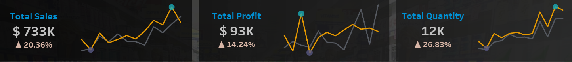
Visualizations
Sparklines:
→ Visualized trends over time, highlighting maximum and minimum values.
KPIs:
→ Developed KPIs to track key metrics like total sales, total profit, and total quantity.
Key Visuals:
→ Sparklines, KPI Cards, Graphs.

Slide 4
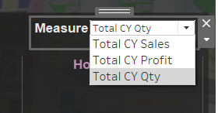

Interactivity and User Experience
Filters and Parameters:
Added interactive filters to allow users to explore data dynamically.
Integrated parameters to enable flexible, user-driven data interaction.
Navigation:
→ Implemented light and dark mode switcher for improved accessibility and user experience.

Slide 5
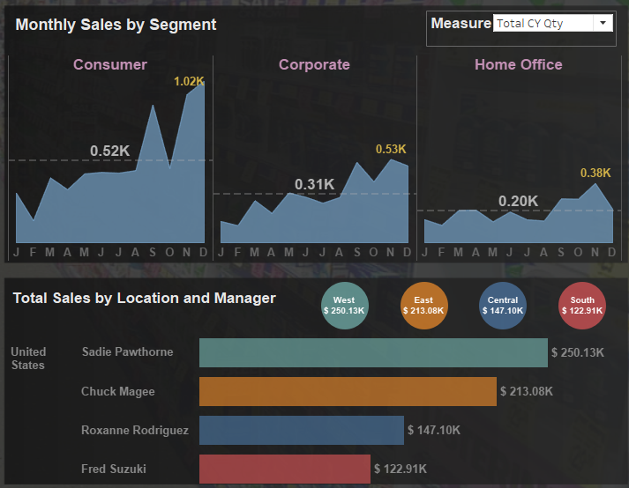
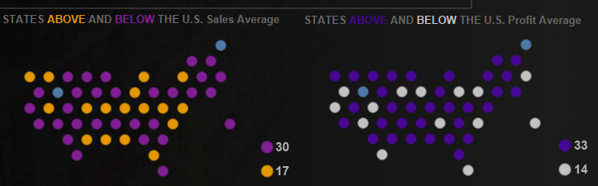
Business Insights
Key Insights:
Sales and profit distribution by state, highlighting above/below-average performance.
Monthly sales trends by segment, with performance evaluation by location and manager.
Impact:
→ Empowered stakeholders to make informed decisions and optimize sales strategies.

Slide 6
Conclusion
Summary:
→ Developed an interactive and dynamic sales dashboard that provides deep insights into sales performance.
→ Enhanced decision-making through advanced calculations, visualizations, and a user-centric design.
Suggestions
Identify high-performing products/services and promote them.
Address underperforming areas with targeted strategies.
Personalize marketing based on customer data.
Improve customer service and implement loyalty programs.
Offer targeted discounts, dynamic pricing, and product bundles.
Expand e-commerce and leverage social media sales.
Train and incentivize the sales team, use sales automation tools.
Segment customers, use targeted ads, and personalized email marketing.
Strengthen brand awareness through content, referrals, and events.
Optimize inventory and negotiate better supplier terms.
GitHub Link: https://github.com/ram0109/Sales-Dashboard-Tableau/tree/main
Thankyou!
Ram Prasad

Slide 7
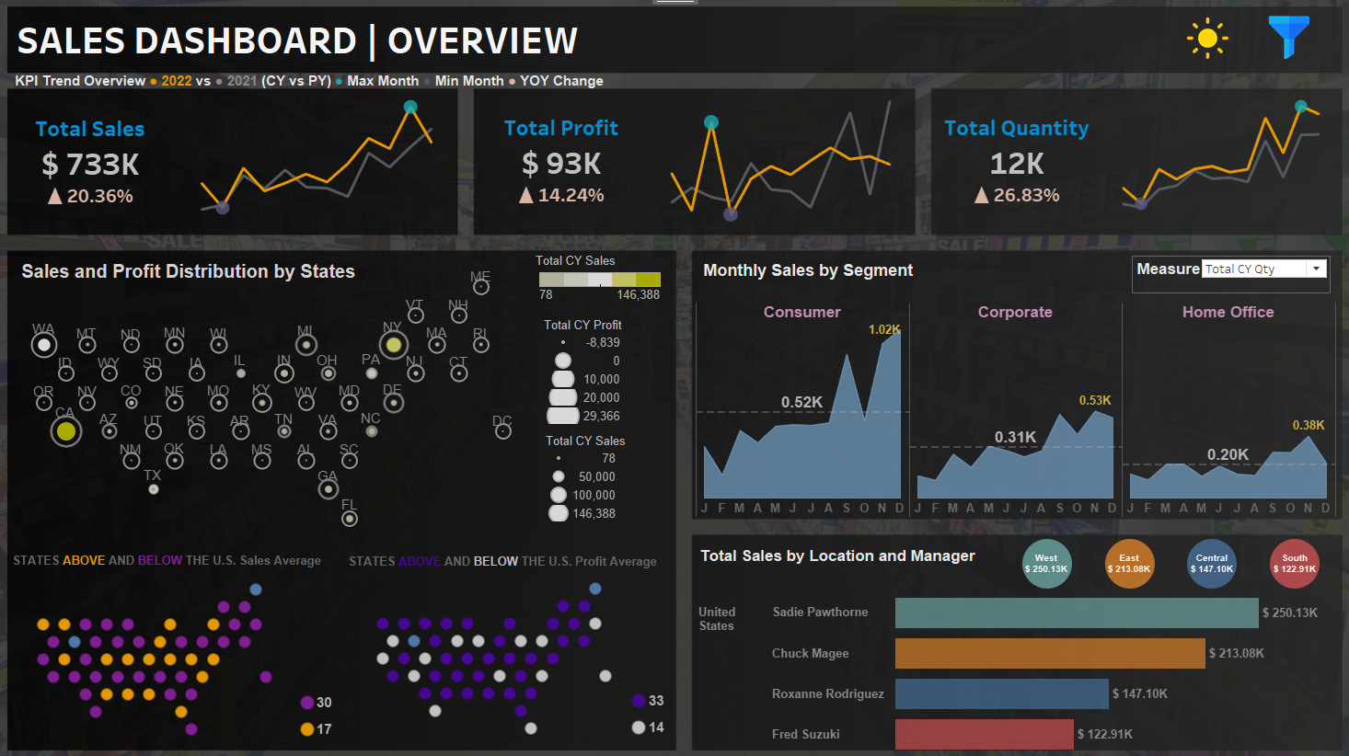

Slide 8
